Slide 1
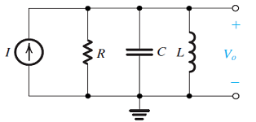
Quiz 7.1
Deadline: June 5, 2020
Question1
Given R = 10kΩ, C = 0.01μF, design the Antoniou circuit to obtain L = 10mH
Find the transfer function v_{o}/I.
Compute resonant frequency of the circuit.
What is the quality factor of the circuit?
Find the bandwidth of the circuit.
Question2
Design and plot a first-order high-pass filter using resistance of 100 Ω and the Antoniou circuit with the following specification:
3-dB frequency: ω_{3dB} = 10 krads/s
Amplitude at the input of the Antoniou circuit is 1v and amplitude of the output signal is 5v (Hint: Use amplifier K together with Antoniou circuit)

